Slide 1

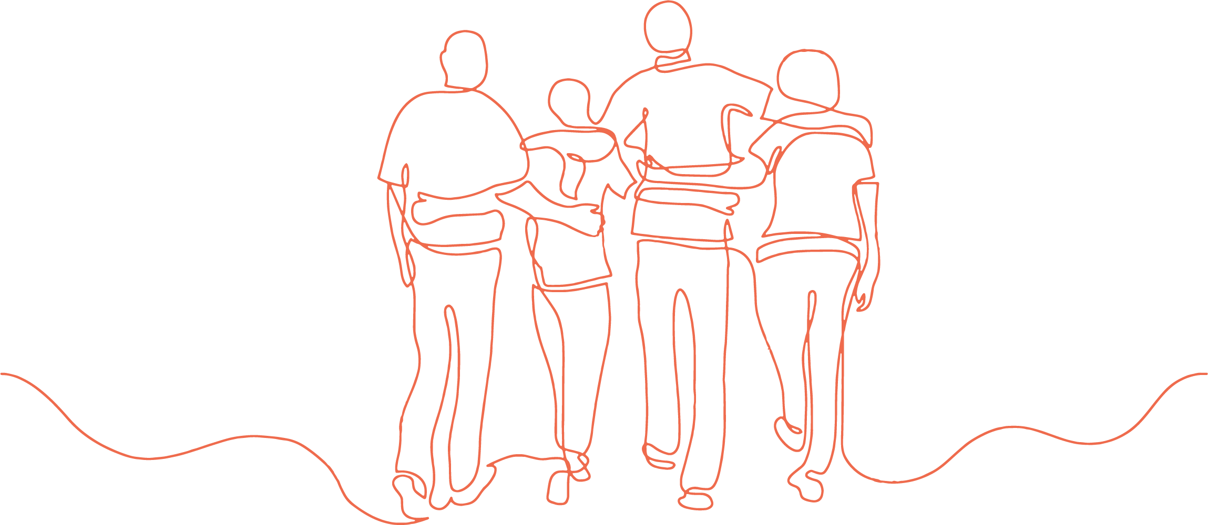
TEACHING PERSPECTIVES OF GENDER AND SEXUALITY IN HEALTH EDUCATION
Dr Emily Lockhart

Slide 2
Outline
Impetus of the study
Grounded theory methodology
Findings
Recommendations
Q&A

Slide 3
Impetus
New Australian Curriculum (2018) which included new content
Shift from medico-scientific perspective to a socio-cultural perspective
Teacher frustration and overwhelm at approaching new curriculum directions without adequate preparation
Lack of consistency across schools

Slide 4
Methodology - Grounded Theory
Qualitative
Inductive
Reflective process
Provide a window through which to see the lived experience of others
Develop a theory to answer the question - What is going on here?
Pilot
Screening
Three phase study
Semi-Structured interviews
Notes:
Qualitative – narrative accounts, interview.
Inductive - start with no theory or prior theoretical understanding. Let the data drive the thinking
Screening – teachers had to be currently teaching PSCH in years 7-10.
Semi-structured interviews - Broad overarching questions, followed by questions specific to the responses of the participants.
Interviews intended to be a conversation, with respondent and myself having equal responsibility for discussion.

Slide 5
Methodology - Grounded Theory
Pilot Study
2 participants
Phase one
23 participants
9 male, 14 female
What's your involvement with teaching health at the moment?
Phase two
22 participants
Inform, extend, and refine the themes from Phase 1.
Can you give some examples of content that you feel could be interpreted in different ways?
Phase three
19 participants
What do participants believe and why?
What does ‘healthy’ mean?
Notes:
Pilot – phase one interview and feedback
Phase two and three increasingly focus on why and where the beliefs came from.

Slide 6
Findings
Focused data
Memoing
Categorization
Themes
Framework
Health Education Teaching Perspective
Health Education Teaching Enactment
What am I supposed to say?
Notes:
One main theme was teachers saying they don’t now what to say. Do they share their beliefs? Do they say what the school wants? Do they pander to the parents? Students? An acknowledgement they will upset someone. Also not wanting to offend.
First thing teachers need it to be clear on their personal perspective, then they need to decide how to act on that.
How do teachers navigate this? How do teachers of different faith backgrounds, upbringing, beliefs, and personal practices know what to say?
What are we supposed to say? Emerged as the core phenomenon in this study as teachers grappled with working out “what they are supposed to say about these topics. Their personal views are not the only impact here – the school has a view, the parents, the students.

Slide 7
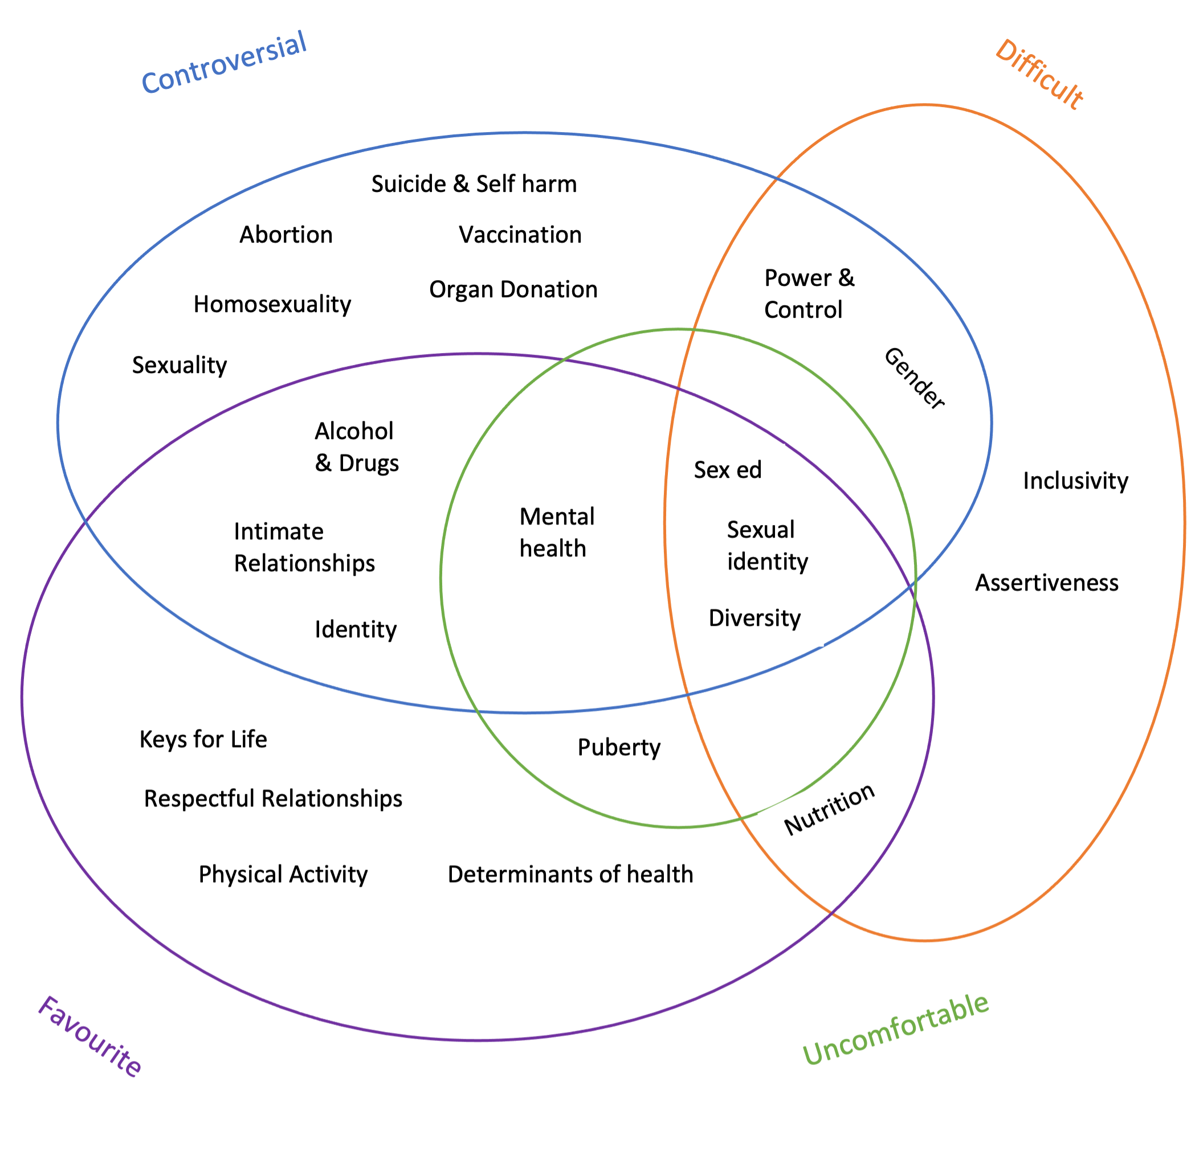
Notes:
Teachers spoke about their teaching and mentioned many topics they teach. These were referred to by participants as favourite, difficult, uncomfortable and controversial.
Interesting to note the middle – Sex Ed, Sexual identity, and diversity. All were favourites to teach, difficult, uncomfortable and controversial.
Rory – I like to engage kids when I teach, so the hardest most uncomfortable things are the things that the kids don’t want to engage with.

Slide 8
Content open to interpretation
Emotions
Controversial topics
Body Image
Mental Health
Stereotypes
Alternatives to medicine
Gender
Sexuality
Diversity
Unsafe or challenging situations
Alcohol and other drugs
Sexual Identity
Homosexuality
Help-seeking
Identity
Sex ed
Contingency plans
Media
Intimate relationships
Health Literacy
Norms
Notes:
When controversial topics combine with topics that teachers believe are open for interpretation. Open for interpretation meant the curriculum does not specify what to say about these things but simply lists them as a topic to be covered.
When a topic is open for interpretation, the teachers personal beliefs will have a higher degree of interaction and ”come into play” more - it is proposed.
Combine this with the core phenomenon of – What am I supposed to say?

Slide 9






Low sharers
Mediated sharers
High sharers
Some degree of teacher sharing.
Facts
At times, rarely or when asked specifically
High degree of teacher sharing.
1st Person
Bible
Documentary, Media, Book, video story telling
3rd Person sharing
Statistics to show norms
Colour code | Participants
Yellow | 2
Green | 2
Purple | 3
Pink | 2
Orange | 10
Blue | 3
Notes:
When teachers described what they do say in class, we plotted these responses onto a spectrum. Which turned out to delineate into low, mediated and high sharing of personal beliefs.

Slide 10
Worldview
Secular₃
A secular society where religious belief is one option among many options. Within this paradigm a viable choice is no religion at all or rejection of religion or religious affiliation.
Secular₂
Areligious people, lack of religious beliefs or religious affiliation. An espoused neutral or non-religious stance.
Religious
Belief in a transcendent reality beyond the immanent order of nature, believing in God and/or being affiliated with a religion or partaking in religious practices.
Secular₃ – a secular age or society
Secular₂ |  |  | Religious
Postmodernism | Existentialism | Naturalism | Deism | Christian Theism
Smith, J. K. A. (2014). How (not) to be secular: reading Charles Taylor. William B. Eerdmans Publishing Company.
Notes:
There are more philosophy catergories but these ones represent the worldviews in my participant pool
Deism – A transcendent God created the universe but then left it to run on its own. May partake in religious practices.
Christian Theism - God is infinite and personal (Triune), transcendent and immanent, omniscient, sovereign and good.
Naturalism - God may or may not exist, but the God hypothesis is unnecessary for comprehending the universe, or There is no God and it doesn’t matter.
Existentialism - People make themselves who they are. The person creates value.
Postmodernism - The shift from an emphasis on being in the premodern world, to knowing in the modern world, to meaning in the postmodern world. Language as power. Can we be good without God.

Slide 11
Worldview & Sharing behaviours
Low sharers
Mediated sharers
High sharers
Existentialism
Existentialism
Christian Theism
Naturalism
Religious Deism
Post Modernism
Christian Theism
Religious Deism
Naturalism
Religious Deism
Naturalism
Espoused Neutrality
Existentialism
Guidance
Post Modernism
Notes:
When we map the sharing behaviours with the worldviews, Christian people are mediated to high sharers.
It is interesting to note that There are no Christians in the low sharer group. Also most of the low sharers worldviews focus on freedom, individual choice and student agency. Post modern teachers see themselves as facilitators (not there to impart knowledge), existentialists teachers encourage students to form their own perspective. In all these worldviews the teacher is not there to guide, but rather present facts and promote critical thinking and student agency to decide for themselves. There is no ‘right’ way or no ‘truth’.
High sharers in this study are predominately people with a Christian worldview, where the emphasis is on guiding children and teaching Gods truths. They believe there is a truth and children should be provided advice and guidance, rather than left to decide for themselves.
naturalist teachers believe in scientific method and explicit instruction, teaching facts and research skills. It makes sense they are in all three areas as it is the teachers understanding of ‘sharing’ that is important here. They do focus on teaching facts and ‘science’ so could believe they are low sharers, while others believe they are sharing their beliefs as they are guiding students to also believe in and understand the natural world. Some acknowledge they intentionally lead the learning in a certain way or choose provocations to guide learning, they also impart their knowledge to the students.

Slide 12
Quotes
“I had to tread very carefully, and I’d say stuff like, this is just, these are just my beliefs, don't have to be your beliefs, and I'd start the sentence with that.”
“we obviously have to be the filter between society. And teachers, I think being that filter in between is probably the most difficult part. And that's what, why it's probably controversial for a teacher, because being able to filter what public perception are, and then put it in a way that students can understand. But still leaving it open ended for them to make their own decision, is probably the most difficult aspect.”
“I think it's a societal, it's got to be societal and a lot of we've got to be very careful because a lot of students form, they get values and as they develop, they inherit values, they develop attitudes, and through their parents, and family, and cultural upbringing and societal beliefs.”
Notes:
Green – high sharer – Christian.
Orange – mediated sharer – Christian
Blue – Low sharer – postmodern.

Slide 13
Neutrality or Guidance?
Christian Worldview
Responsibility as an educator
Moral formation
How can Health Teachers provide clear and cohesive guidance for the moral formation of adolescents?
Notes:
Christian schools employing Christian teachers is more than saying a prayer or devotions in class. It is about their deeper philosophical worldview, and the Christian worldview is focused on guidance, where as other worldviews may attempt to be neutral and allow students to make their own choices. While on the surface this seems ok that students make their own choices, this is a dangerous path as students are not taught God’s truth and learning is destabilized as there is no truth. Developmentally children aren’t ready to make such choices and need guidance.
The Christian worldview believes the responsibility of teachers (and parents and church leaders) is moral formation of students and guidance toward the truth (God’s truth).

Slide 14
Framework
Personal Perspective
Clarity
Support Structures
Interpretation
PSCH Syllabus
Health Education Teaching Perspective Formation
Health Education Teaching Perspective Enactment
Initial teaching perspectives
Agreement/ Alignment
Teaching perspectives
Expectations
Value of Health Education
Time
Teaching behavioural choices
Sharing behaviours
Avoidance behaviours
Teaching methods
Authentic

Slide 15
Implications for practice
Teachers need to explore worldview
Curriculum clarity
Call for curriculum guides
Increased support in schools for health education
Schools increase guidance on school stance
Upskill teachers – Need PL
Increase time in schools for health teaching

Slide 16
Implications for research
Psychological and sociological aspects of interpretation
Why low value of health education?
Avoidance behaviours – what is commonly omitted?
Critical Health Literacy approach
Impact of assessment
Pedagogy exemplars
Self-awareness training

Slide 17

RISE – Relationships, Identity, and Sexuality Education
Christian Worldview
Virtue Community Institute
Professional Learning
Virtue Lane Community
We are committed to fostering learning environments grounded in our core virtues:
Compassion, Kindness, Humility, Gentleness, and Patience.
www.virtuecommunity.com.au

Slide 18

Questions

