Slide 1

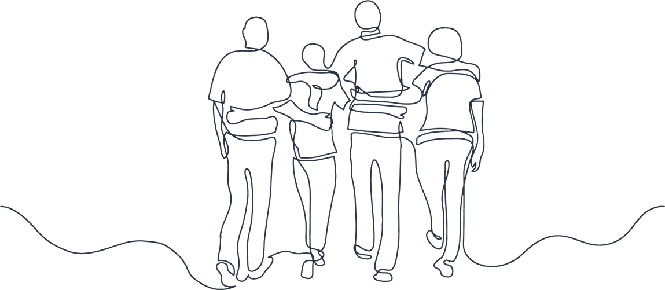
A Case Study of Virtues-Based Education in a Christian School
Dr Emily Lockhart
www.virtuecommunity.com.au
Notes:
I want to start with a question that I have been sitting with for a long time.
When we teach children sexuality education, what are we actually trying to do?

Slide 2

Wisdom
Formation
... the kind of wisdom that shapes character and enables flourishing.
That is Virtues-based pedagogy.
Notes:
Often the rationales for sexuality education in schools centre on developing skills and knowledge, while also preparing students for the future. Yes. Sexuality education is all those things. But I want to suggest today that in Christian education, we are trying to do something more.
We are trying to form people. We are trying to help children understand not just what is happening to them, but who they are becoming — and to discover God's will for their lives.
The Wisdom stream of this symposium asks how we form people to attend to the broader world beyond mere information acquisition — how we cultivate not just knowledge, but the kind of wisdom that shapes character and enables flourishing. I want to suggest today that virtues-based pedagogy is the practical mechanism for doing that. Not as an abstract philosophy, but as a classroom reality.

Slide 3


The gap
Biology
Theology
Notes:
Let me start with the honest reality.
Sexuality education in Christian schools has often been caught in an awkward middle space. The secular health curriculum provides the biology. Christian education provides the scripture. But rarely, if ever, do the two speak to each other in the same lesson, in the same breath, as part of the same conversation.
The result? Teachers who feel caught between two modes — clinical and theological — and who often choose one or the other. Or they teach the biology and then bolt on a prayer at the end, which, as one of the teachers in my study put it, is just “tacking it on afterwards, and it doesn’t do either one justice.”
There is also the reality that sexuality education is deeply sensitive territory. Many teachers find it daunting. Some avoid it altogether. In one conversation during this research, a teacher described her school's male colleague who had simply not taught puberty that year — because he didn't know how and didn't have any resources to help him.
This is not just an anecdote. My own doctoral research into the delivery of the personal, social and community health strand of the Western Australian HPE curriculum found that teachers in faith-based school contexts navigate a particularly complex and largely unspoken negotiation — between the sociocultural expectations of the national curriculum on one side, and the theological and relational commitments of their school community on the other (Lockhart, 2022). What that research found absent was curriculum resources specifically designed to support Christian school teachers in delivering this content from within a coherent theological framework. Teachers were left to improvise that integration individually, without structural or resource support. The male colleague who simply didn't teach puberty that year was not an outlier. He was the logical endpoint of a system that asks Christian school teachers to deliver sensitive health content but gives them no framework for doing so on their own terms.
This is the gap. And this research was an attempt to address it.

Slide 4
Virtue ethics
Aristotle
Thomas Aquinas
Kristánsson's (2018)
Human Flourishing.
Eudaimonia.
Formation of moral character.
Phronesis, practical wisdom.
Virtuous Emotions.
Emotions themselves can be morally educated.
Moral understanding.
Notes:
To understand the program, you need to understand the theoretical framework that underpins it.
Virtues-based pedagogy draws on one of the oldest traditions in the history of education — the virtue ethics tradition rooted in Aristotle and carried into Christian thought most deeply through Thomas Aquinas. At its core, virtue ethics holds that the goal of human life is flourishing — what Aristotle called eudaimonia — and that flourishing is achieved not through acquiring knowledge alone, but through the formation of character.
Writing in the Nicomachean Ethics, Aristotle’s central claim is that virtues — stable dispositions to feel, judge, and act well — are not innate but acquired through habituation. This carries radical pedagogical implications: moral character is not primarily a matter of knowing the right rules, but of having one’s dispositions shaped through repeated practice within a community of formation.
Central to this is the concept of phronesis, or practical wisdom — the master virtue that cannot be taught didactically but is developed through experience, reflection, and the guidance of virtuous exemplars. The teacher, on this account, is not merely a deliverer of content but a moral presence whose own character is formative for students.
This is precisely what the Wisdom stream of this symposium calls us to attend to. Our students are navigating a world of shifting moral frameworks and complex cultural currents regarding sexuality. To engage with that world well, they need more than biological facts; they need practical wisdom — the capacity to discern, to reflect, and to act well. Phronesis is not a bonus in health education. It is the goal.
But practical wisdom is not purely cognitive. This is where Kristánsson's work becomes directly relevant to what we are trying to do in a puberty classroom. In Virtuous Emotions (2018), Kristánsson argues that emotions themselves can be morally educated — that the goal of virtue pedagogy is not to manage or suppress feelings but to cultivate them, to bring them into alignment with moral understanding. A student who feels shame about their changing body, or contempt toward a peer navigating puberty differently, is not simply experiencing a natural adolescent response. They are, in Kristánsson's terms, experiencing a morally uneducated emotion — one that virtue pedagogy has both the responsibility and the capacity to address. This is why the program does not simply name virtues and move on. It provides students with the neurological rationale for why those emotions are arising, and then invites them to practise responding to those emotions virtuously. The science and the virtue are not two separate conversations. They are one.

Slide 5
Virtue ethics
Aristotle
Thomas Aquinas
MacIntyre (1981, 2007)
Annas (2011)
Smith (2023)
Human Flourishing.
Eudaimonia.
Formation of moral character.
Phronesis, practical wisdom.
Virtue is acquisition of a skill.
The social environment.
The classroom itself.
Notes:
Aristotle’s framework was revived most influentially by Alasdair MacIntyre’s After Virtue (1981, 2007), and extended by Julia Annas’s Intelligent Virtue (2011), which argues that virtue is analogous to the acquisition of a skill — involving both practical know-how and affective engagement. Chris Smith’s more recent work (2023) presses this further still, arguing that virtues develop through the social environment of the classroom itself — how we structure the learning space, not just what we teach, is an act of formation.

Slide 6
Christian virtue ethics
Imago Dei
The Fruits of the Spirit
Brant, Brooks and Lamb (2022)
Made in the image of God.
Gifts of grace.
A transformed life.
A fundamentally different institutional culture.
Notes:
In the Christian context, virtues-based pedagogy takes on a further dimension. Christian virtue ethics holds that the human person is made in the image of God, that our telos is not just flourishing in the Aristotelian sense, but life in God, and that virtues are not only cultivated by practice but are also gifts of grace. The fruit of the Spirit — love, joy, peace, patience, kindness, goodness, faithfulness, gentleness, self-control — are not just aspirational qualities. They are descriptions of what a transformed life looks like.
Brant, Brooks and Lamb’s Cultivating Virtue in the University (2022) makes a compelling case that genuine virtue formation requires not merely the addition of virtue language to existing curricula, but a fundamentally different institutional culture — one oriented toward a shared telos. For Christian schools, that telos is life in God. The program that this research is based includes scripture, prayer, and virtue language woven throughout every lesson and are an attempt to build that kind of formative culture.
This gives us rich ground for health education. What if sexuality education in a Christian school was not just about biological information, but about forming children in the virtues they will need to navigate life well?
What if, instead of organising the curriculum by bodily system, we organised it by virtue?

Slide 7
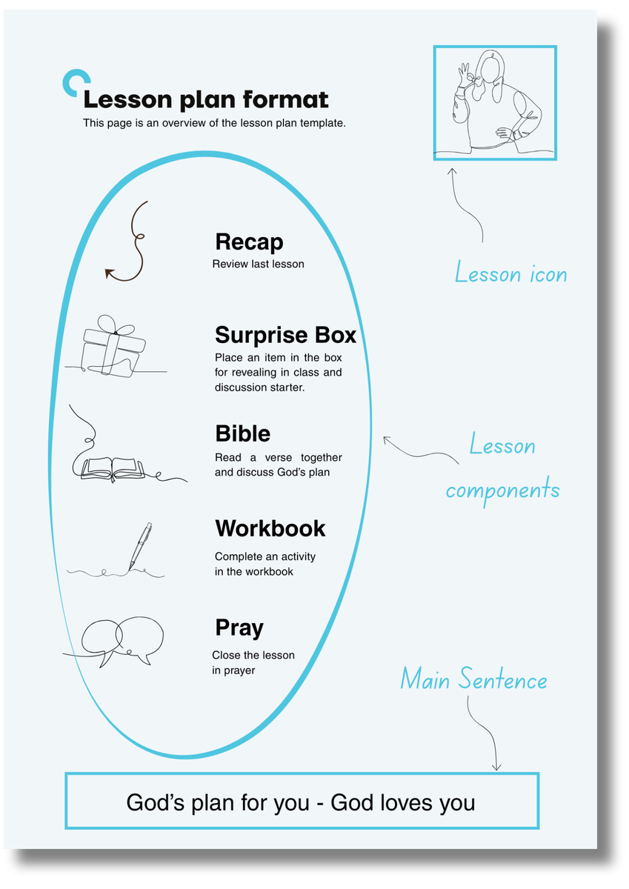
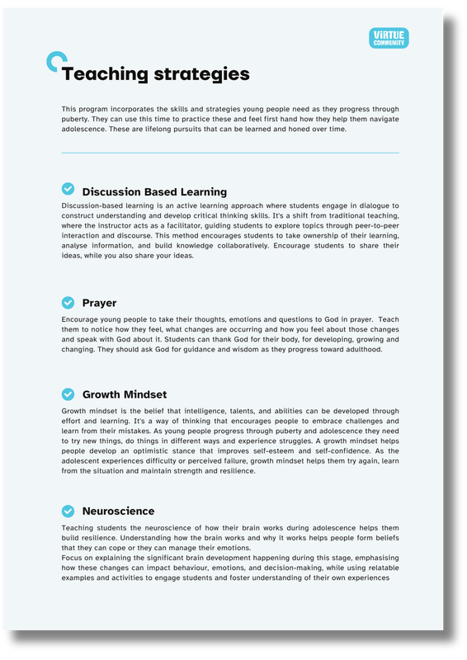
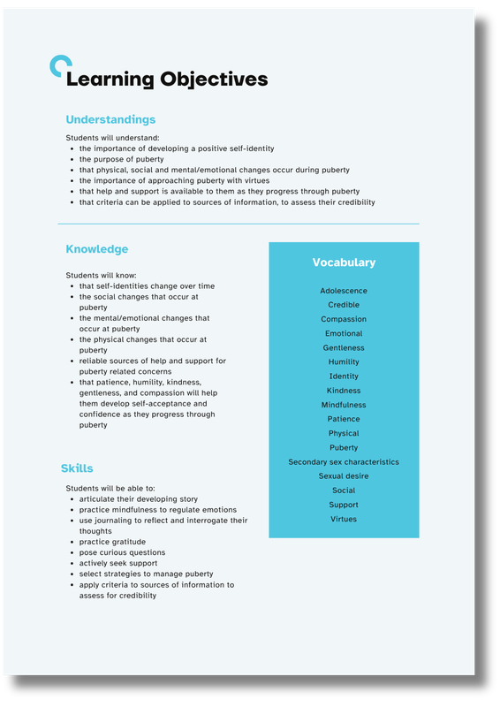
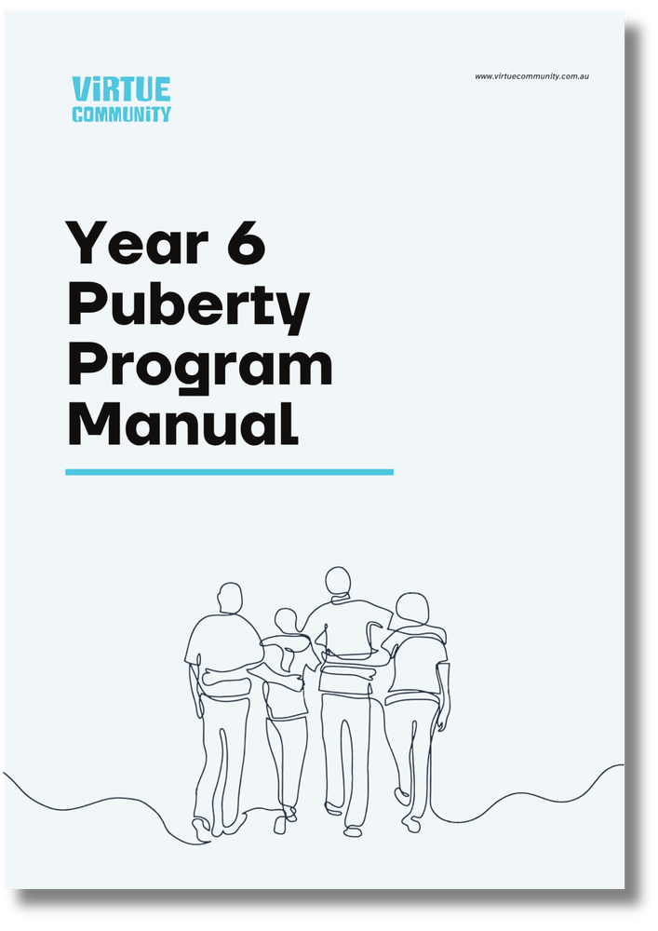
The Year 6 Puberty Program, Pilot (2025).
Notes:
That question became a program. Developed by Virtue Community in partnership with Sheridan Institute of Higher Education, the Year 6 Puberty Program is an eight-lesson curriculum in which each lesson takes its name, its shape, and its moral direction from a specific virtue.

Slide 8
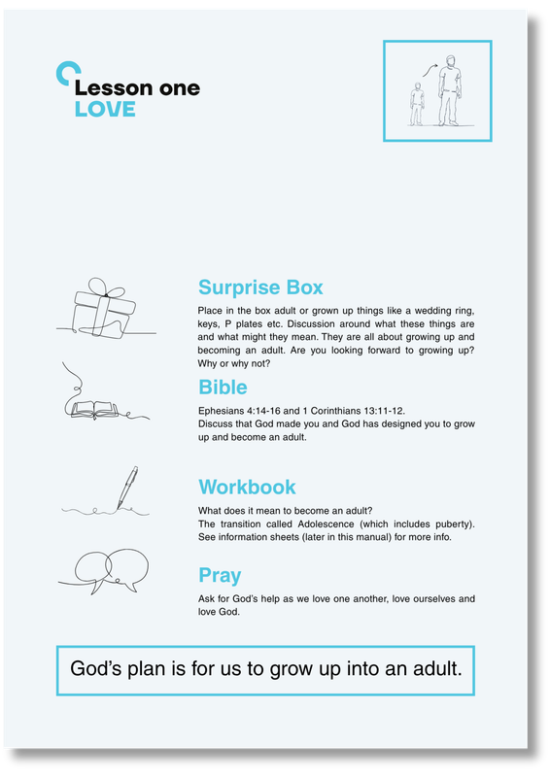
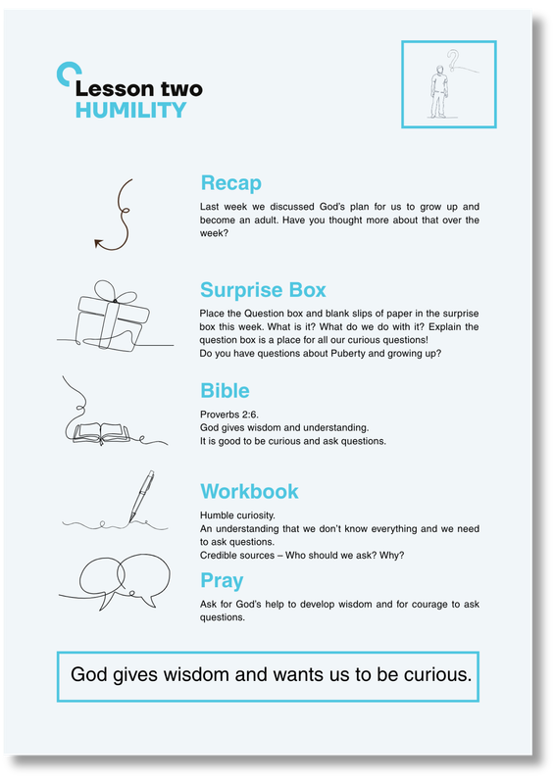
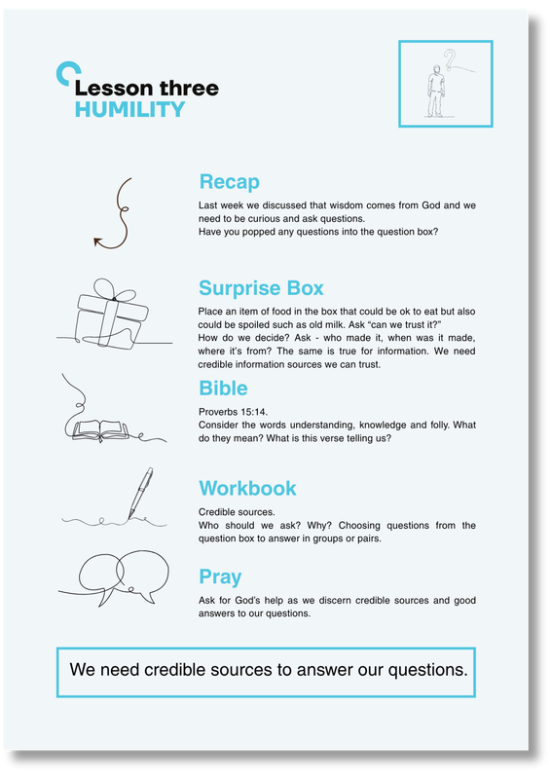

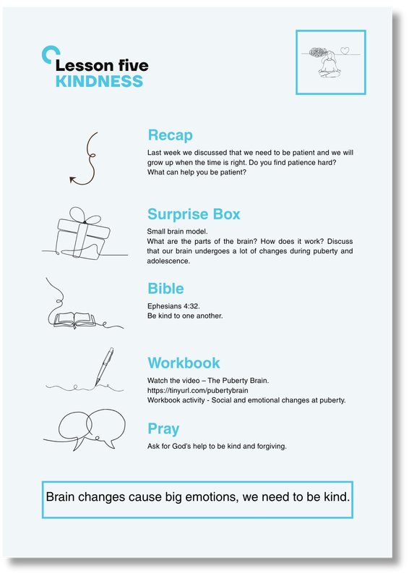
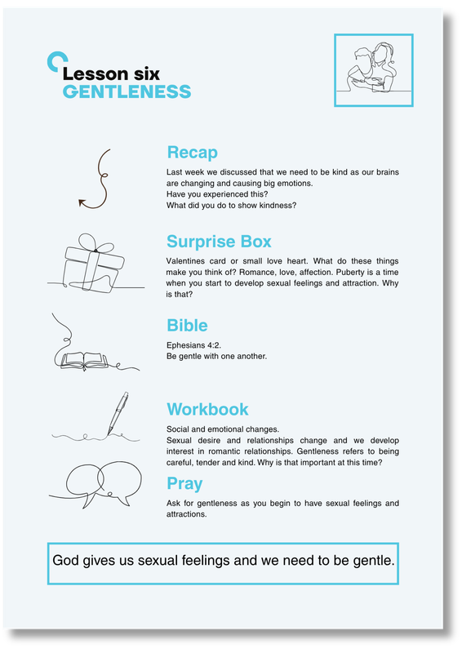
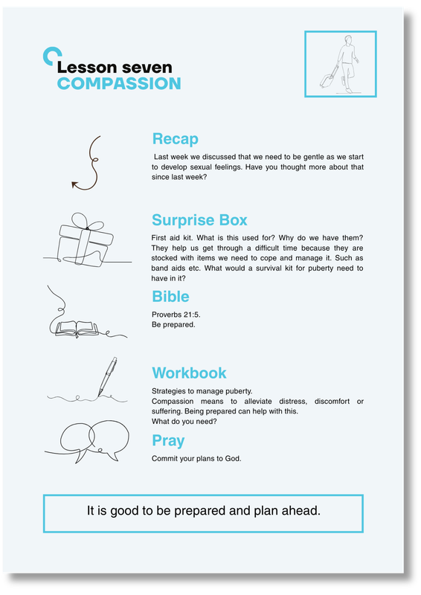
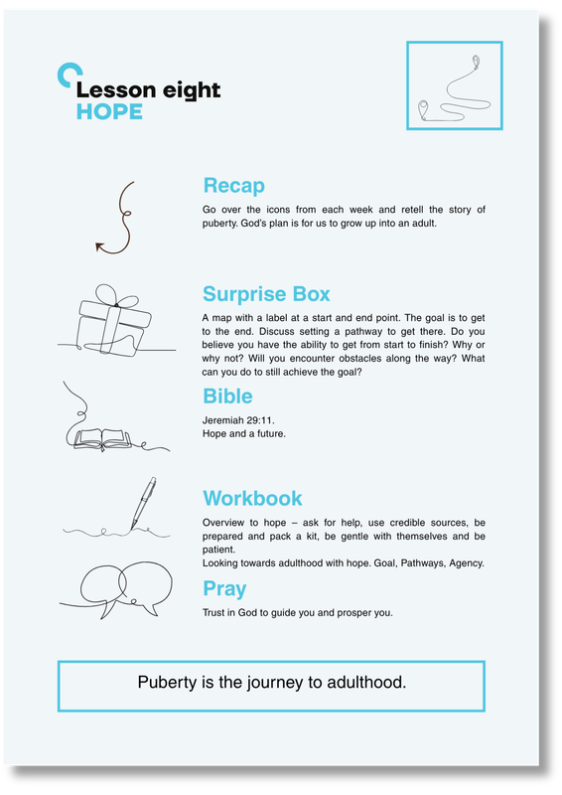
Notes:
Lesson One: Love. Lesson Two: Humility. Lesson Three: Humility. Lesson Four: Patience. Lesson Five: Kindness. Lesson Six: Gentleness. Lesson Seven: Compassion. Lesson Eight: Hope.

Slide 9
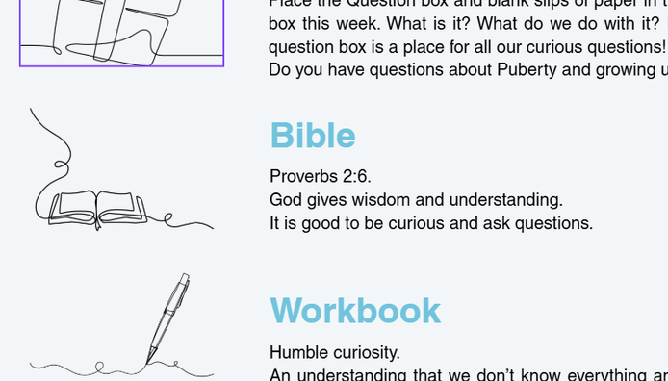
Lesson Structure
Notes:
Each lesson follows a consistent structure: Recap, Surprise Box, Bible, Workbook, and Pray.
The Recap reviews the previous week, building continuity. The Surprise Box is a tangible object placed in a gift box that opens the lesson with curiosity and discussion. In Lesson One on Love, it contained things like L and P plates, car keys, a wedding ring, Panadol — items that prompt a conversation about what it means to grow up and take on adult responsibility.
The Bible section reads a scripture passage that connects the virtue to the lesson content. In Lesson Two on Humility, that is Proverbs 2:6 — “God gives wisdom and understanding. It is good to be curious and to ask questions.” This frames humility not as self-deprecation, but as the intellectual and spiritual posture of a learner who knows they don’t know everything — which is exactly what we need from a Year 6 student asking questions about their changing body.
The Workbook is where something pedagogically significant happens, and it is worth being precise about what that is. The Workbook functions as a deliberate, formalised Reflect step in the learning process. This is not merely a task to complete.

Slide 10
Learning Theory
Kristánsson (2022)
Bruner (1986)
Youngs (2021)
First person engagement.
Virtue phenomenologically.
The art of narrating.
Constructivism learning theory.
Active learners.
Constructing own meaning.
Narrative Pedagogy.
The power of storytelling.
Personal narratives.
Story of faith.
Notes:
Drawing on constructivist and narrative pedagogical traditions, this step actively moves students from information acquisition to genuine formation — synthesising the biological facts they have encountered, and practising the art of narrating themselves as people of character. Kristánsson's (2022) gives us a framework for why this matters: virtue formation requires the student's own first-person engagement, not passive reception. The workbook is the structural mechanism that demands exactly that — it requires the student to occupy the virtue from the inside, in their own words, applied to their own life. When a student writes their personal plan to live the virtue, they are, in Kristánsson's terms, appropriating the virtue phenomenologically — making it their own. — synthesising the biological facts they have encountered, and practising the art of narrating themselves as people of character.
Bruner’s constructivist learning theory posits that learners are active participants who construct their own meaning and mental models of the world, rather than passively acquiring knowledge. As MacIntyre reminds us, we can only understand what we ought to do if we understand the story we are part of. Youngs (2021) argues that narrative pedagogy is especially powerful in Christian educational contexts precisely because it aligns the student’s developing personal narrative with the larger story of faith.

Slide 11
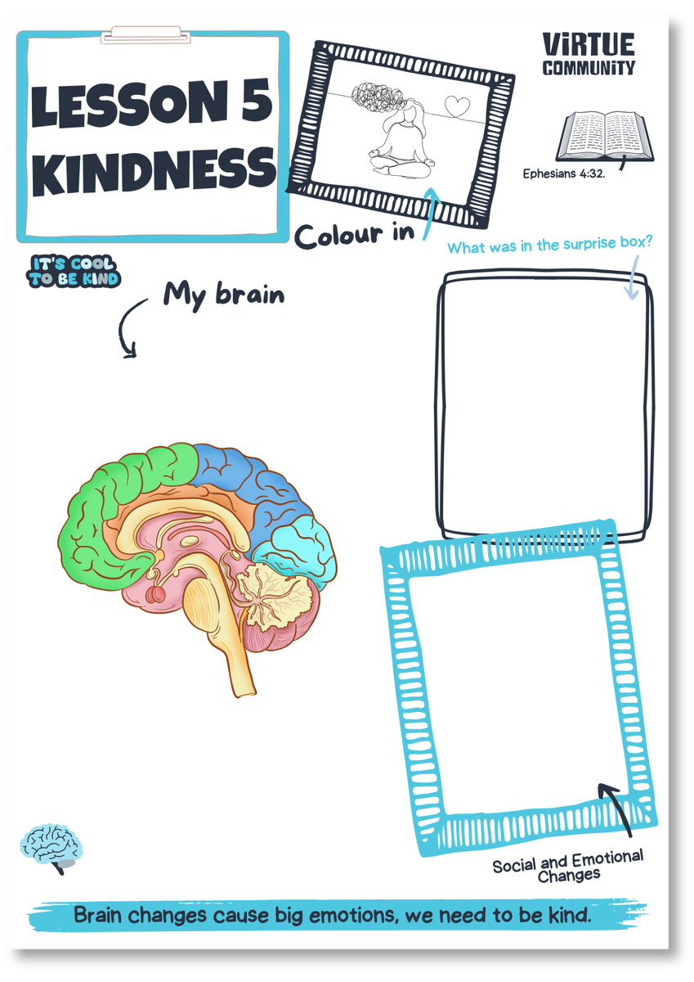
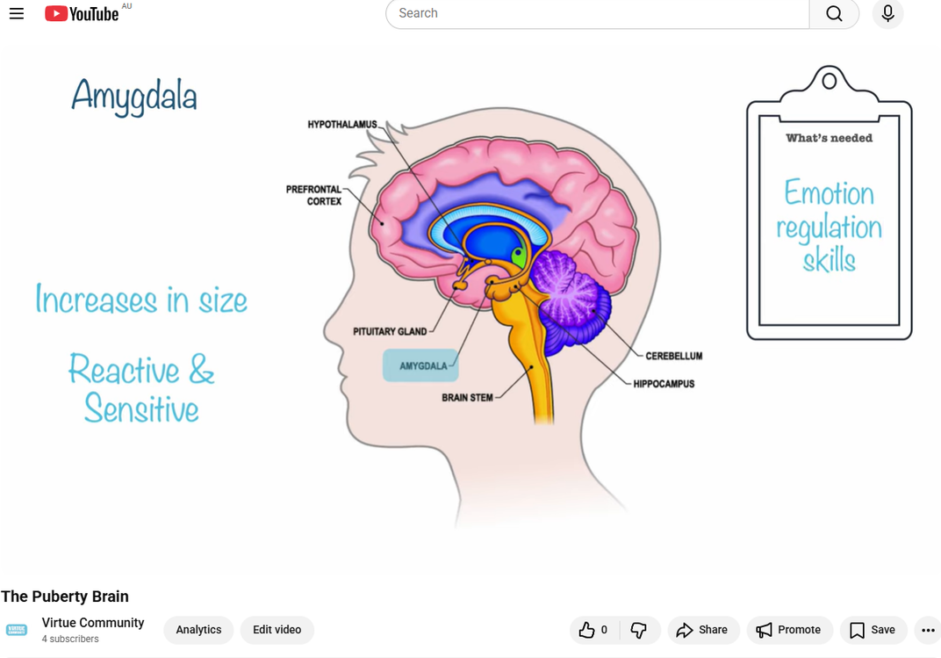
Neuroscience
Notes:
This Reflect step of having students complete the workbook page each lesson, matters especially for how we teach the science. For example, in Lesson Five on Kindness, students engage with neuroscience — but not passively. We pause the videos. We label diagrams together. The science is explicitly interactive and visual. Pilot data showed this approach was particularly valuable for neurodiverse learners — including students with autistic characteristics — who benefit considerably from seeing complex, abstract biological changes mapped out clearly and discussed collaboratively, rather than simply delivered.
From that interactive engagement, students construct the key insight: “Brain changes cause big emotions. We need to be kind.”

Slide 12
Virtue-based Pedagogy
Tabibnia (2024)
Kristánsson (2018)
Understand the biology.
Self-regulation.
Moral understanding.
Morally educated emotion in formation.
Notes:
Tabibnia’s research (2024) shows that when students understand the biological basis of their emotional responses, they develop greater capacity for self-regulation. The programme does not merely name the virtue; it provides the neurological rationale for why that virtue is needed right now, in this body, at this age. This is Kristánsson's (2018) argument made concrete: the program does not treat the amygdala's reactivity during puberty as a problem to be managed, but as the very site where virtue formation becomes possible and necessary. When a student understands why their brain is causing them to feel oversensitive or impulsive, and then commits — in their own handwriting — to practising kindness, that is a morally educated emotion in formation.

Slide 13
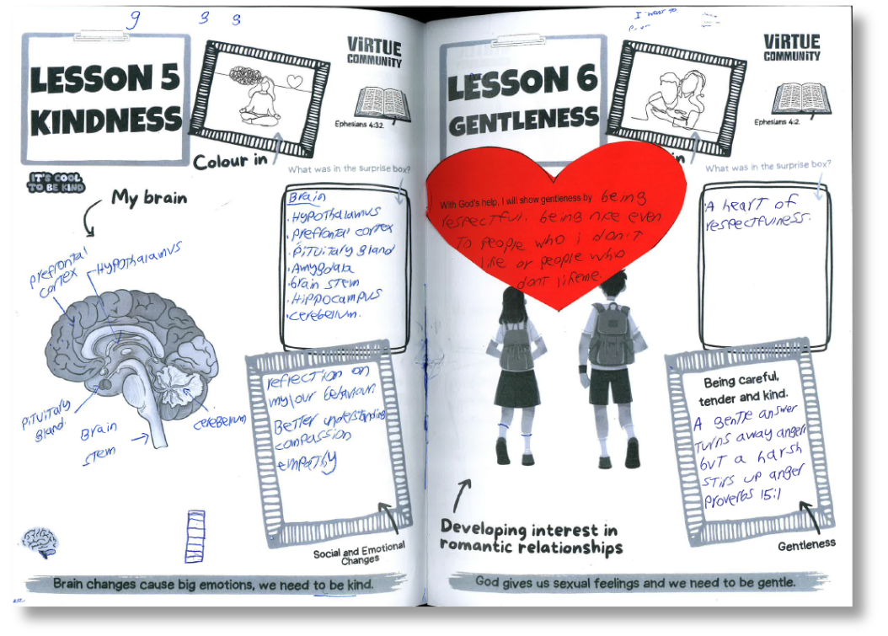
Quote
"With God’s help, I will show gentleness by being respectful, being nice even to people who I don’t like, or people who don’t like me."
Notes:
In Lesson Six on Gentleness, students engage with the development of romantic feelings. In their own handwriting in the student workbooks I received from this pilot, one student wrote inside a large red heart:
"With God’s help, I will show gentleness by being respectful, being nice even to people who I don’t like, or people who don’t like me."
That is a twelve-year-old making a moral commitment — a virtue commitment — in the context of a health lesson. That is virtues-based pedagogy working.
The lessons close with Prayer, asking God for help to live out the virtue that has been explored. This is not decoration. This is the theological grounding of the whole enterprise: that character formation is not something we do alone, but something we do with God.

Slide 14

Methodology
Qualitative case study pilot
Ethics
In partnership with Sheridan Institute of Higher Education and approved by the Human Research Ethics Committee at the Christian Research Association.
Participant
Year 6 teacher in a Christian school in WA.
Data collection
Multi-modal. Multiple methods, over time.
60 minute semi-structured interview, reflective journal, written feedback after the program concluded, and student work samples from the completed workbooks.
Notes:
This was a qualitative case study pilot. Its purpose was not to generate large-scale statistical data, but to trial the program in a real classroom, with a real teacher, and gather rich qualitative data about what worked, what didn’t, and what needed to change before a wider rollout.
The research was conducted in partnership with Sheridan Institute of Higher Education and approved by the Human Research Ethics Committee at the Christian Research Association. The participant was a Year 6 teacher in a Christian school in Western Australia; pseudonyms were used throughout.
Trialling this specifically in Year 6 is deeply intentional. As secondary health teachers navigate ongoing and often complex curriculum reform in Western Australia and beyond, establishing this virtues-based language in primary school equips students with a foundational moral vocabulary before they encounter the higher-stakes health lessons in Year 7. Formation, if it is to be genuine, must begin early.
Data collection was multi-modal: a sixty-minute semi-structured interview, a weekly reflective journal, written feedback after the program concluded, and student work samples from the completed workbooks. This breadth of data, gathered across multiple methods and over time, is what gives the study its validity — not its scale.

Slide 15

Quote
"I think the way that you structured it, with tying it in with the Bible… linking it to the Bible, and this is part of God’s plan for us, it might be more comfortable. And realising, you know, this is nothing to be embarrassed about… just tying it constantly with ‘this is part of God’s plan’, it sort of made me more comfortable with the idea."
Notes:
Let me share some of the findings in the teacher’s own words, because their voice is the most important data we have.
On the integration of virtue and biblical content with health education, we have this quote:
"I think the way that you structured it, with tying it in with the Bible… linking it to the Bible, and this is part of God’s plan for us — it might be more comfortable. And realising, you know, this is nothing to be embarrassed about… just tying it constantly with ‘this is part of God’s plan’ — it sort of made me more comfortable with the idea."
The teacher is describing a shift — not just in the students' experience, but in her own. The theological framing of puberty as God's design reduced shame and increased confidence. And teacher confidence is not a soft variable here — it is one of the most consistently documented predictors of puberty education quality in the Australian literature. Burns et al. (2022) demonstrate that primary school teachers report low comfort with puberty-related content, and that this discomfort directly and measurably affects the completeness and quality of what gets delivered in the classroom. What the pilot data suggests is that the mechanism for building that confidence in a Christian school context is not primarily professional development in content knowledge — it is theological coherence. When the curriculum gives teachers a framework that aligns with their own worldview and moral vocabulary, the affective barrier drops. That is a finding with practical implications well beyond this one program.
Carr argues in Character in Teaching (2007) that the teacher’s virtues are not merely useful for effective teaching but are constitutive of it. This is precisely why the programme includes a teacher education component. As Sanderse captures it: virtue is ‘caught as well as taught’, and how teachers approach a sensitive topic models those very virtues, regardless of the explicit content of the lesson.

Slide 16
Quote
"These virtues, I am constantly talking about them being in Year 6. They are sometimes a real pain. So we’re constantly talking about compassion, kindness, humility, all of those things. It ties in really well with my devotions that I do every morning as well. And then I can go and reinforce that again with the health plan."
Notes:
On the transfer of virtues beyond the health lesson:
"These virtues — I am constantly talking about them being in Year 6. They are sometimes a real pain. So we’re constantly talking about compassion, kindness, humility, all of those things. It ties in really well with my devotions that I do every morning as well. And then I can go and reinforce that again with the health plan."
This is transfer. The virtues explored in the health lesson bled into morning devotions, into how the teacher responded to social conflict, into the ongoing moral formation of the class community. James Arthur’s Education with Character (2003) and the Jubilee Centre’s Framework for Character Education (2017) both identify this whole-school effect as a hallmark of effective virtue education. The pilot data shows it.

Slide 17
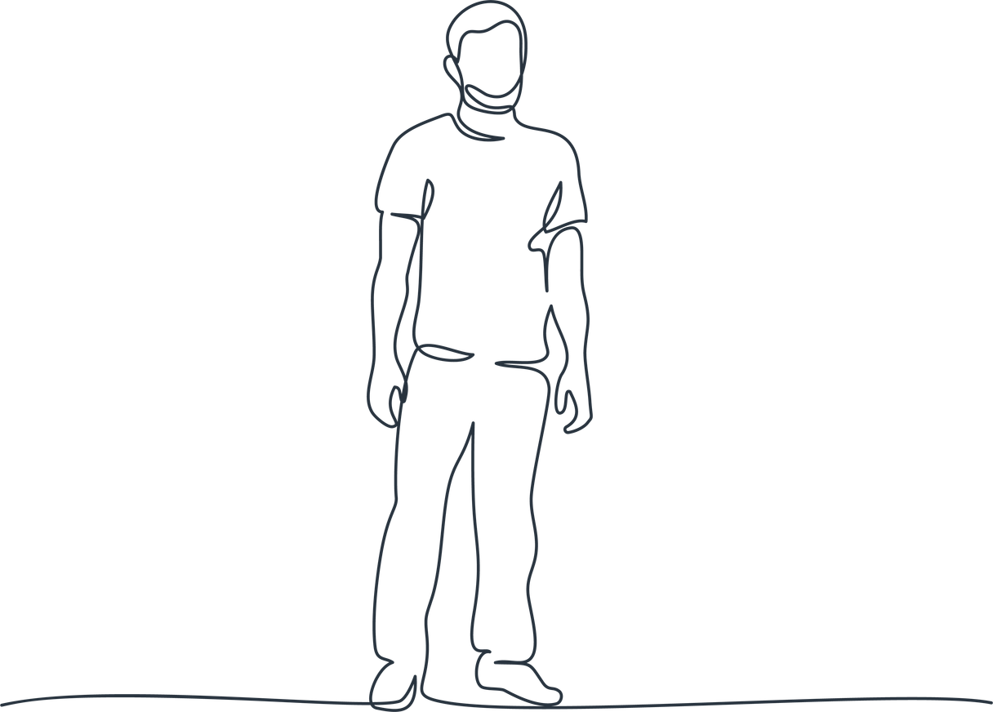
Quote
"I have never had a class that was so respectful with puberty. Especially the boys, how they wanted to know about the girls. It was a great opportunity and the boys learned a lot more. They’ve got a better understanding of what the girls are going through."
Notes:
On classroom culture:
"I have never had a class that was so respectful with puberty. Especially the boys — how they wanted to know about the girls. It was a great opportunity and the boys learned a lot more. They’ve got a better understanding of what the girls are going through."

Slide 18
Improvements
Parents
Learning intentions and Success Criteria Clearer connections between Bible verses and lesson content
More structured assessment template
Notes:
There were also areas for improvement found in this study and we are working to update the resource to include these improvements.
One finding that deserves a mention — because it speaks directly to what Christian schools are uniquely positioned to do — is the parent inclusion gap. The program currently gives parents no direct window into what their children are learning. The teacher put it simply: students don't generally share what happened in class, and parents are left without the vocabulary or the prompts to continue the conversation at home. In a program grounded in Christian virtue formation, that is a significant missed opportunity. The home is not merely an extension of school-based learning in a Christian framework — it is a primary site of faith formation. If we are asking students to practise gentleness and compassion as part of God's design for their lives, and then sending them home to families who have no idea that conversation has been happening, we are working against our own formative logic. A simple parent resource — weekly virtue prompts, lesson overviews, conversation starters for the dinner table — would close that loop. This is on the development roadmap for the next iteration of the program.
There were also other areas for improvement — the need for more explicit learning intentions, clearer connections between Bible verses and lesson content, and a more structured assessment template. These are not failures. They are exactly the kind of findings a pilot study is designed to generate. They are the difference between a good program and a great one.

Slide 19
This matters
Edlin (2014)
Van Brummelen (2009)
No neutral curriculum.
Christian approach to curriculum.
Not merely the addition of biblical references to secular content.
Notes:
Christian schools exist because we believe that education is not merely functional — not just about skills and knowledge or academic achievement — but about formation. We believe that children are made in the image of God, that they are persons of infinite dignity, and that education should serve their flourishing as whole human beings.
Edlin, in The Cause of Christian Education (2014), puts it plainly: there is no neutral curriculum. All education is formation in some direction. Van Brummelen’s Walking with God in the Classroom argues that a Christian approach to curriculum is not merely the addition of biblical references to secular content, but a fundamentally different orientation to knowledge, human nature, and the telos of education.
And yet, in health education, we have often allowed a split to persist. We teach the biology in one space and the theology in another, and we never quite find the courage or the framework to let them speak to each other.
The existing literature does not adequately address this intersection. Virtue-based character education has a growing body of scholarship. Health and sexuality education has its own substantial literature. Christian schooling has its own. But the specific intersection of all three — virtues-based pedagogy applied to health education within Christian schools — remains almost entirely unaddressed.
The Virtue Community programme is a pioneering attempt to fill that gap. Not by reducing health education to a Bible study, and not by secularising the curriculum until the faith dimension is invisible, but by holding them together, coherently, in a way that honours both.
When a twelve-year-old writes in their workbook that they will show gentleness to people who don’t like them, and names God as the one they are relying on to do it — that is a child who has not just received information about puberty but has been invited to navigate those changes as a person of faith and virtue. That is what the Wisdom stream calls us to build.

Slide 20
Wisdom
Formation
What kind of person are we forming?
Notes:
I began by asking what we are really trying to do when we teach sexuality in a Christian school.
I want to suggest that the answer is formation. We are trying to form human beings who can navigate their lives with skills, with knowledge, with grace, with faith, and with virtue.
The Wisdom stream of this symposium names the right question: not merely what information can we transmit, but what kind of person are we forming?
Virtues-based pedagogy in health education is one concrete, research-grounded answer to that question.
The research I have shared today is early. It is a pilot. It is one teacher, one school, one year group. But the findings are genuinely encouraging — not because every element of the program worked perfectly, but because the fundamental premise was validated: that teaching puberty through the lens of virtue, anchored in scripture, embedded in the language and practice of character formation, and grounded in rigorous science taught interactively and inclusively, produces something qualitatively different from what most schools are currently doing.
It produces students who are respectful of one another’s bodies and experiences. It produces teachers who feel theologically grounded rather than awkward. It produces classrooms where difficult conversations can happen because virtue has created the relational conditions for them to do so.
It produces, in short, a context where learning and formation are not two separate things but one.
That is wisdom. And that is what Christian education is for.

Slide 21
Annas, J. (2011). Intelligent virtue. Oxford University Press.
Aristotle. (2000). Nicomachean ethics (R. Crisp, Trans.). Cambridge University Press. (Original work c. 350 BCE)
Arthur, J. (2003). Education with character: The moral economy of schooling. RoutledgeFalmer.
Berkowitz, M. W., & Bier, M. C. (2005). What works in character education: A research-driven guide for educators. Character Education Partnership.
Brant, J., Brooks, E., & Lamb, M. (Eds.). (2022). Cultivating virtue in the university. Oxford University Press.
Bruner, J. (1986). Actual minds, possible worlds. Harvard University Press.
Burns, S., Saltis, H., Hendriks, J., Abdolmanafi, A., Davis-McCabe, C., & Tilley, J. M. (2022). Australian teacher attitudes, beliefs and comfort towards sexuality and gender diverse students. Sex Education, 23(5), 540–555. https://doi.org/10.1080/14681811.2022.2087177
Carr, D. (2007). Character in teaching. British Journal of Educational Studies, 55(4), 369–389. https://doi.org/10.1111/j.1467-8527.2007.00386.x
Carr, D., & Steutel, J. (Eds.). (1999). Virtue ethics and moral education. Routledge.
Edlin, R. J. (2014). The cause of Christian education (4th ed.). National Institute for Christian Education.
Halstead, J. M., & Reiss, M. J. (2003). Values in sex education: From principles to practice. RoutledgeFalmer.
Jubilee Centre for Character and Virtues. (2017). A framework for character education in schools. University of Birmingham.
Kristánsson, K. (2015). Aristotelian character education. Routledge.
Kristánsson, K. (2018). Virtuous emotions. Oxford University Press.
Kristánsson, K. (2022). Phenomenology and virtue pedagogy. Routledge.
Lickona, T. (1991). Educating for character: How our schools can teach respect and responsibility. Bantam Books.
Lockhart, E. (2022). The interrelationship between a teacher's worldview, personal beliefs, and the delivery of the personal, social and community health strand of the Western Australian Health and Physical Education Curriculum, within secondary schools [Doctoral dissertation, Alphacrucis University College].

Slide 22
MacIntyre, A. (1981). After virtue: A study in moral theory. University of Notre Dame Press.Sanderse, W. (2012). Character education: A neo-Aristotelian approach to the philosophy, psychology and education of virtue. Eburon Academic Publishers.
Smith, C. A. (2023). The pedagogy of a classroom for intellectual virtues. Episteme, 1–11. https://doi.org/10.1017/epi.2023.17
Smith, D. I. (2018). On Christian teaching: Practicing faith in the classroom. Eerdmans.
Tabibnia, G. (2024). Neuroscience education as a tool for improving stress management and resilience. Current Opinion in Behavioral Sciences, 59, Article 101401. https://doi.org/10.1016/j.cobeha.2024.101401
Van Brummelen, H. (2009). Walking with God in the classroom (3rd ed.). ACSI.
Youngs, S. (2021). Exploring narrative pedagogy: Story, teaching, and the development of virtue. International Journal of Christianity & Education, 25(1), 18–30. https://doi.org/10.1177/2056997120971658

Slide 23
Dr Emily Lockhart
www.virtuecommunity.com.au

